Slide 1
Theft of tokens | PF 54 part 6

Slide 2
The ultimate goal for an attacker that focuses their attention on an Oauth aware target is to steal an access token. The access token lets the attacker perform all kinds of operations that they were intended to be able to do.
We already saw how Oauth clients send access tokens to resource servers to consume APIs. This is usually done by passing the bearer token as a request header( Authorization: Bearer access_token_value).
RFC 6750 defines two other ways to pass the bearer token along. One of those, the URI query parameter, states that clients can send the access token in the URI using the access_token query parameter. Although the simplicity makes its use tempting, there are many drawbacks to using this method for submitting the access token to a protected resource.
The access token ends up being logged in access.log files as part of the URI.
People tend to be indiscriminate in what they copy and paste in a public forum when searching for answers (for example, Stackoverflow). This might well end up having the access token being pasted in one of these forums through HTTP transcripts or access URLs.
There is a risk of access token leakage through the referrer similar to the one we have seen in the previous section, because the referrer includes the entire URL.
This last method can be used to steal access tokens.
Let’s assume there is an Oauth client that sends the access token in the URI to the resource server, using something like the following:
https://oauthapi.com/data/feed/api/user.html?accesss_token=2hguiuj2jjj2vbvbv2kkk2bb88877m
If an attacker is able to place even a simple link to this target page (data/feed/api/user.html) then the Referer header will disclose the access token as shown in below diagram:

Slide 3
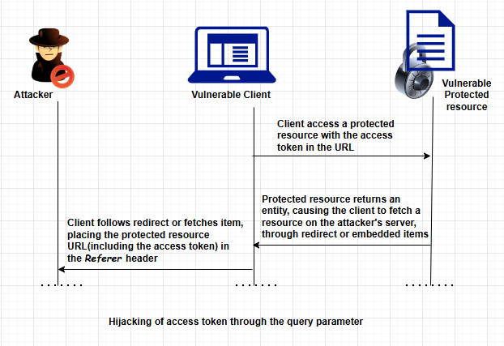
Using the standard Authorization header avoids these kinds of issues, because the access token doesn’t show up in the URL. Although the query parameter is still a valid method for Oauth, clients should use it only as a last resort and with extreme caution.
Authorization Server Mix-up
In January 2016, a security advisory was posted to the Oauth working group mailing list describing an Authorization server Mix-up discovered separately by researchers from the University of Trier and the Ruhr-University Bochum. The attack might effect Oauth clients that have client Ids issued by more than one authorization server, effectively tricking a client to send secrets (including client secrets and authorization codes) from one server to another malicious server.
As a temporary mitigation, a client should register a different redirect_uri value with each authorization server. This will allow it to differentiate between requests without getting callbacks confused.

Slide 4
Thanks ☺

